Slide 1
EV – RENTAL
ANALYTICS
EXCEL DASHBOARD PRESENTATION BY
WAFA SHAKKIR

Slide 2
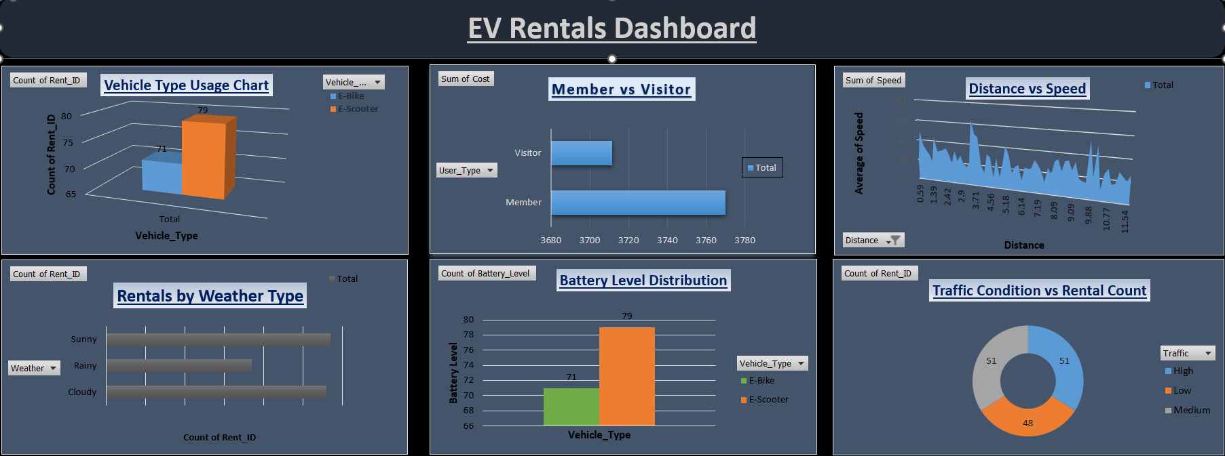

Slide 3
Dataset Overview
About the Dataset:
Total Records: 150 Rentals
Vehicle Types: E-Bike, E-Scooter
Numerical Columns:
  Rental Duration
  Distance
  Battery Level
  Cost
  Speed
Categorical Columns:
  User Type
  Weather
  Traffic
  Start & End Stations

Slide 4
Dashboard Objective
This dashboard analyzes EV rental operations to understand vehicle usage patterns, user behavior, operational performance, and external factors like weather and traffic.

Slide 5
Vehicle Type Usage Chart
Comparison between E-Bike and E-Scooter rentals
E-Scooters (79 rentals)
E-Bikes (71 rentals)
E-Scooters are slightly more preferred.
Indicates higher customer demand for scooters.

Slide 6
Member vs Visitor (Sum of Cost)
Total revenue generated by Members and Visitors.
Members contribute slightly more revenue.
Members likely have higher engagement.

Slide 7
Distance vs Speed
Relationship between travel distance and average speed.
Speed fluctuates with distance.
No strict linear relationship.
Operational factors like traffic influence speed.

Slide 8
Rentals by Weather Type
Rental count under:
Sunny
Rainy
Cloudy
Sunny weather has highest rentals.
Rainy conditions reduce demand.

Slide 9
Battery Level Distribution
Average battery level by vehicle type.
E-Scooters show slightly higher battery levels.
Battery performance appears stable.

Slide 10
Traffic Condition vs Rental Count
Rental distribution across:
High
Medium
Low traffic
Rentals remain consistent even during high traffic.
EV rentals are used as daily commuting transport.

Slide 11
Conclusion
This EV Rentals Dashboard analyzes 150 rental records to understand vehicle usage, customer behavior, and operational factors. E-Scooters show slightly higher demand than E-Bikes. Sunny weather increases rentals, while traffic does not significantly reduce demand. Members contribute more revenue, indicating strong customer loyalty. Battery monitoring is important to maintain service reliability. Overall, the dashboard supports fleet optimization and business strategy.

Slide 12
THANK YOU

